Slide 1
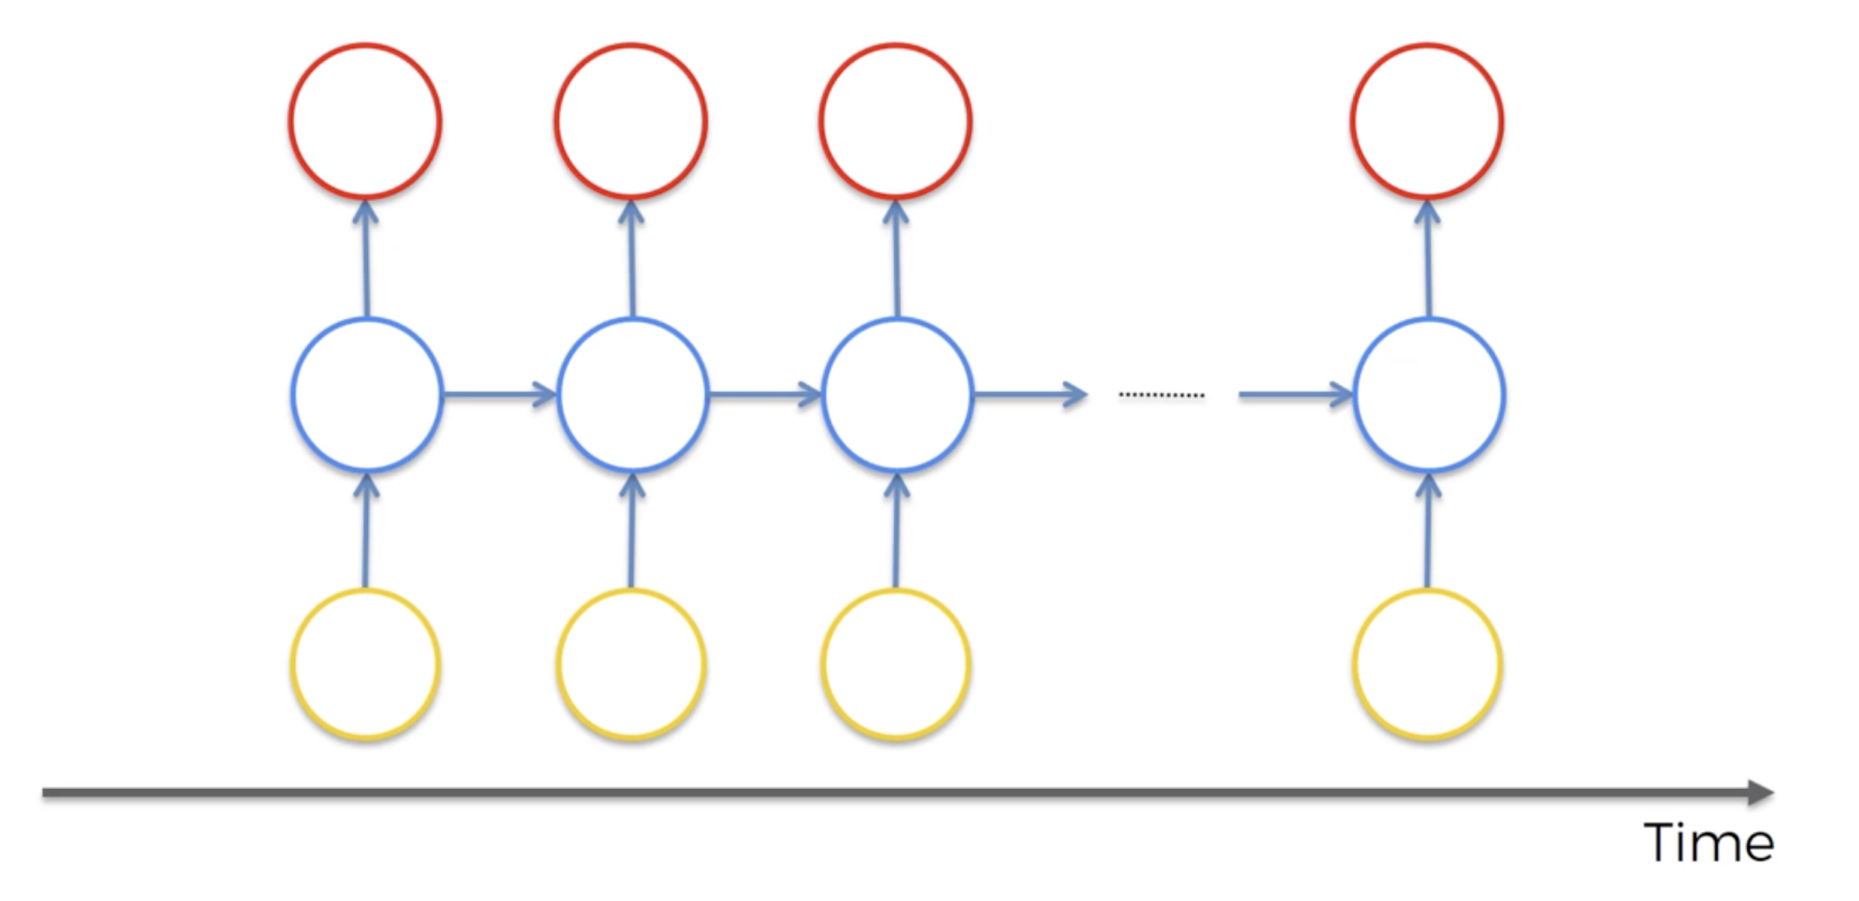
STRUCTURE OF AN RNN ILLUSTRATED WITH A TRANSLATION EXAMPLE
OUTPUTS
Shakira
es
genial
<END>
NEURONS
The same network receiving its own output from the previous step
INPUT SEQUENCE
Shakira
is
great
<END>

Slide 2
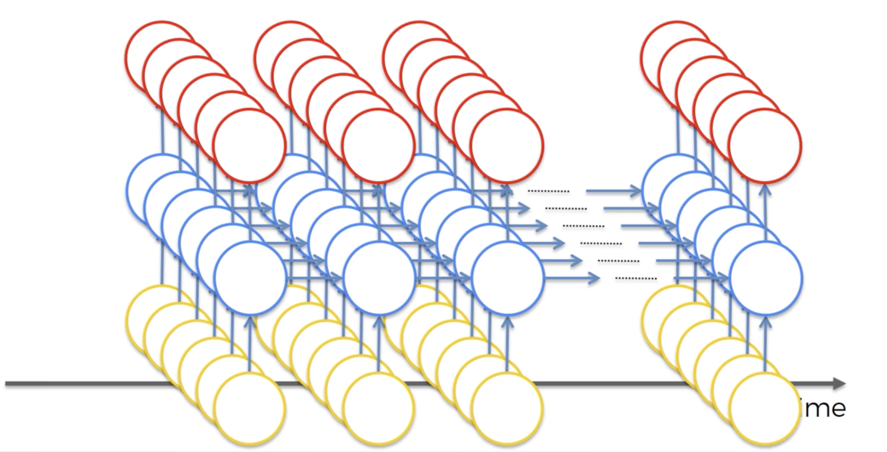
RNNs can be multiple layers deep, taking multi-dimensional input
Shakira
es
genial
Named entity tags
/B-PER
/O
/O
Part of speech tags
Noun
Verb
Adj
Words
Shakira
is
great

Slide 3
